Slide 1
Presentation Skills
Acknowledgement: Margaret Martonosi and Mary Lou Soffa

Slide 2
Communicating Your Ideas Effectively
Essential for
  Disseminating important results
    Ideas don’t sell themselves; they will lie on the shelf and gather dust unless you sell them
  Explaining your work to colleagues
  Teaching concepts in a class
  Giving talks/seminars in industry or academia
  Selling your ideas to funding agencies (or venture capital firms)
  Interviewing for jobs
  Crystallizing your ideas

Slide 3
Forums for
Communicating Your Ideas
Oral
  25-minute conference talk
  “Elevator pitch” or hallway conversation
  Poster Session
  Thesis defense or job talk
Written
  Conference or journal paper
  Dissertation!

Slide 4
Before you start, consider this…
Who is the audience?
  What is their background?
  What will they know or not know?
What are your goals?
  Teach them something?
  Change their minds about something?
  Get them to read your paper?
  Convince someone to hire you?
  When I talk about something in class,
  I discuss it differently than in a research presentation.

Slide 5
The Four Questions
What is the problem?
Why is it important?
What have others done about it?
What am I doing about it?
  That is useful, novel, interesting, different…
  Nearly all oral and written research presentations
  begin from these questions!

Slide 6
Outline
Conference Talk tips
“Elevator Pitch” or hallway conversation
Poster session
Summary and closing thoughts

Slide 7
Oral Presentation:
The Three MUST HAVES
Content: Know your material really well
Design: Organize the material and create a high-quality presentation (usually, for formal research talks, in the form of slides)
  Focus on and drive home key points
  Illustrate with figures and graphs
  Pick and choose: Don’t just repeat the paper in bullet form
Delivery: plan your oral presentation/what you will say along with each slide (write it in notes)
  Practice, practice, practice
  Beware tangents

Slide 8
Conference Talks
Remember
  There is no way you will cover every detail of a 10 page paper in 25 minutes
  The main goal is to get the audience interested in your work so they go read the paper
  The talk is that sales job (but don’t overdo the selling)
  Practice talks with real audiences (eg, fellow students) can help you refine your “story”
Notes:
When I rehearse or present a talk multiple times, I find that I understand better how to drive home the key points

Slide 9
A General Talk Structure (25 mins.)
Title/author/affiliation (1 slide)
Motivation and problem statement (1-3 slides)
Related work (1 slides)
Main ideas and methods (4-8 slides)
Analysis of results and key insights (3-4 slides)
Summary (1 slide)
Future work (0-1 slide)

Slide 10
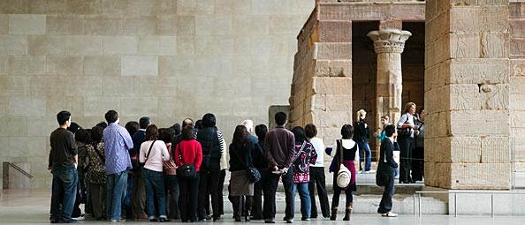
Analogy: A good talk is like a good museum tour…
Informative, easy to hear, information at the right level, just about the right length…
Bad talks…
  Uninformative, hard to hear, or hard to understand…
  The tour goes on too long, so that the material stops being interesting…
  The kidnapping: Never told where we are going or why…

Slide 11
The beginning…
Tell the audience where we are going
And tell the audience why we are going there…

Slide 12
Outline
Background
Related Work
Design
Results
Conclusion

Slide 13
Outline Slide or No Outline Slide:
To be or not to be
Common to start with an outline slide, but…
  It’s too much detail before you’ve told anyone what you are doing…
    Or worse yet, completely vacuous
  Tell the audience more about what the destination is, before you detail out the route you’ll take to get there
But if you wait too long to show the outline slide…
  The audience starts to feel a bit lost…
  Pick a happy medium: Brief motivation, then outline

Slide 14
Outline
Background
Related Work
Design
Results
Conclusion

Slide 15
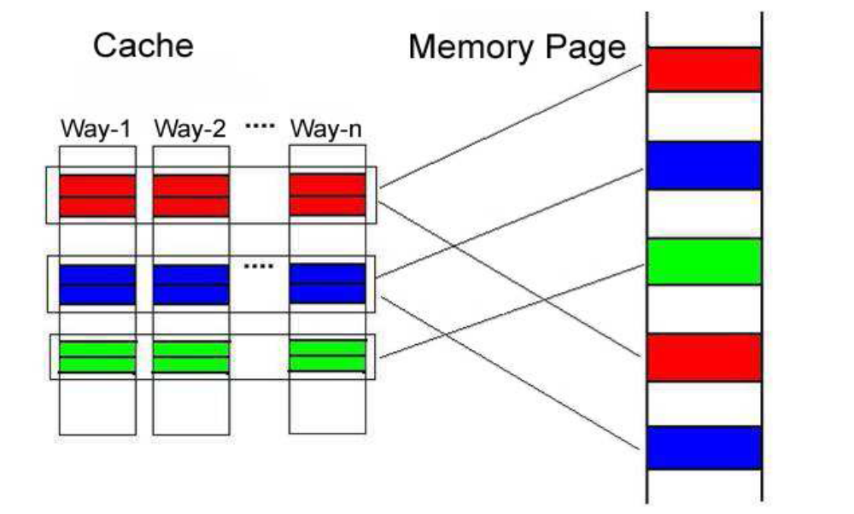
Background:
Brief Introduction of Page Coloring

Slide 16
Instead …

Slide 17
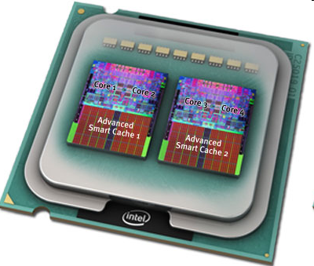
The Multi-Core Challenge
Multi-core chips
  Dominant on the market
  Last level cache is commonly shared by sibling cores, however sharing is not well controlled
Challenge: Performance Isolation
  Poor performance due to conflicts
  Unpredictable performance
  Denial of service attacks
Picture courtesy Intel

Slide 18
Possible Software Solution: Page Coloring
Partition cache at coarse granularity
Page coloring: advocated by many previous works
  [Bershad’94, Bugnion’96, Cho ‘06, Tam ‘07, Lin ‘08, Soares ‘08]
Challenges:
  Expensive page re-coloring
    Re-coloring is needed due to optimization goal or co-runner change
    Without extra support, re-coloring means memory copying
    3 micro-seconds per page copy, >10K pages to copy, possibly happen every time quantum
  Artificial memory pressure
    Cache share restriction also restricts memory share
Memory page
Cache
Way-1
…………
Way-n
Thread A
Thread B
CacheSize
Color # =
PageSize*CacheAssociativity

Slide 19
Our work: Hotness-based Page Coloring
Basic idea
  Restrain page coloring to a small group of hot pages
This paper’s key idea:
  How to efficiently determine hot pages

Slide 20
Outline
Efficient hot page identification
  Locality jumping
Cache partition policy
  MRC-based
Hot page coloring

Slide 21
Related Work
Almost always included in a talk/paper
  Beginning or end?
Think about what your goal is:
  To motivate your own work?
  To appease the authors who are in your audience?
  To convince the audience you are well-informed?

Slide 22
Related Work (less effective)
“A reasonable approach to page coloring”
  ASPLOS ‘06
“Another page coloring idea”
  OSDI ’08
…
Enumerating each paper is only a bare minimum.
  How does the work *relate* to yours? How is yours novel?
Also be sure to consider papers > 5 years old!
And include author names!

Slide 23
Related Work (better!)
System
Changes
Required
Foundational Idea...
Journal of … ‘72
Jones et al.
OSDI ‘08
Smith et al.
ASPLOS ‘06
This Paper
Spatial display of design space can visually highlight what are your novel claims
Also can you show an optimality limit and show how different prior papers approached that limit? Where will your work be?
Runtime Overhead

Slide 24
The middle of the talk…
Methods
  What was most novel or creative about your approach?
  Flowcharts and diagrams to illustrate key components
Results
  Show enough results to get your point across
  Don’t bludgeon the audience with endless unreadable graphs…
  Select a subset to discuss in detail

Slide 25
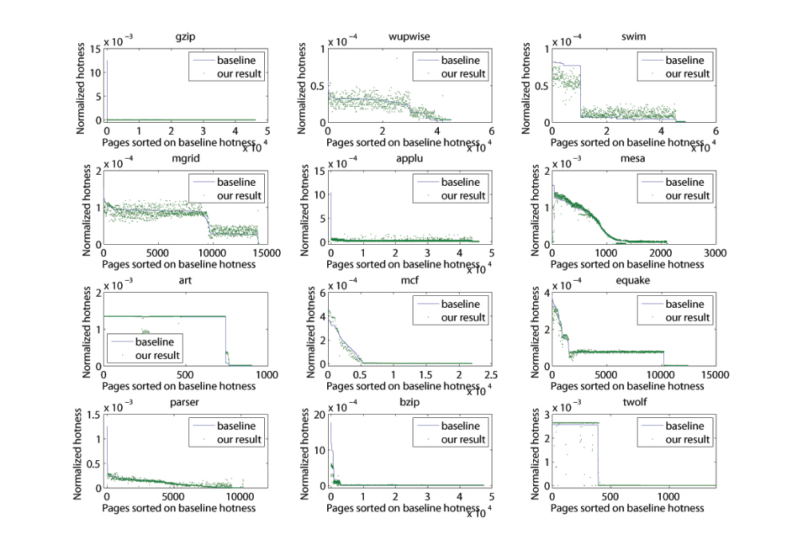
Accuracy
(Bad…)

Slide 26
Instead …

Slide 27
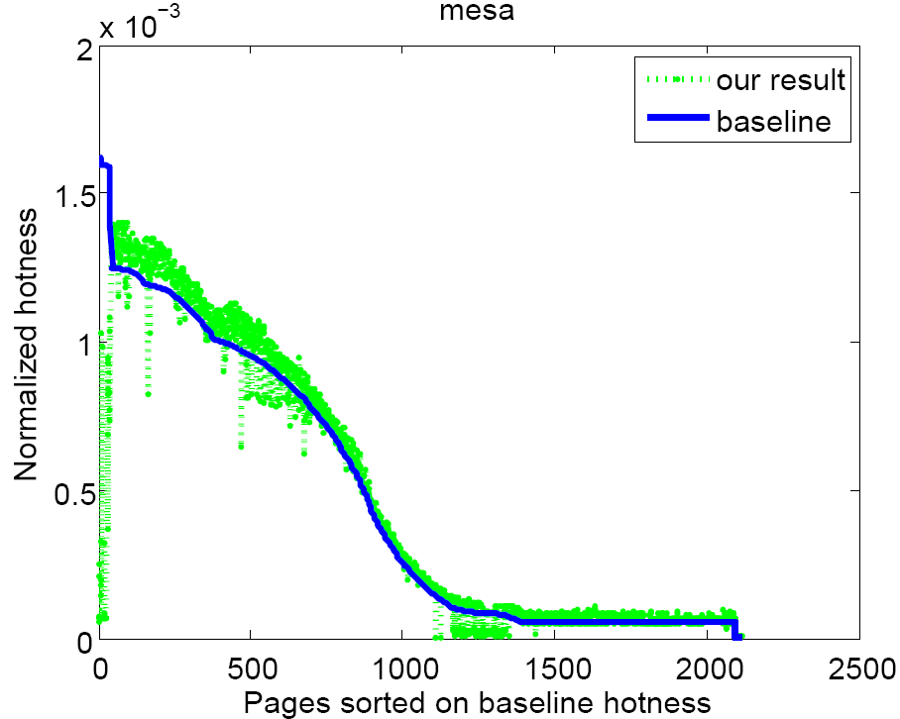
Hot Page Identification Accuracy
No major accuracy loss due to jumping as measured by two metrics (Jeffrey divergence & rank error rate)
Result is accurate within 10%

Slide 28
Illustration and Color
“A picture speaks a 1000 words”
  A 1000 words don’t speak, however
  The picture may need a little help
Color for emphasis (when appropriate)
  Not too much…
  And beware color-blindness (eg, red-green)
Animation when appropriate
  Not too much!
Tip: Record yourself giving a practice talk, and look for places where you are gesturing with your hands to “draw diagrams” in mid-air. That’s a good hint you need another figure there!

Slide 29
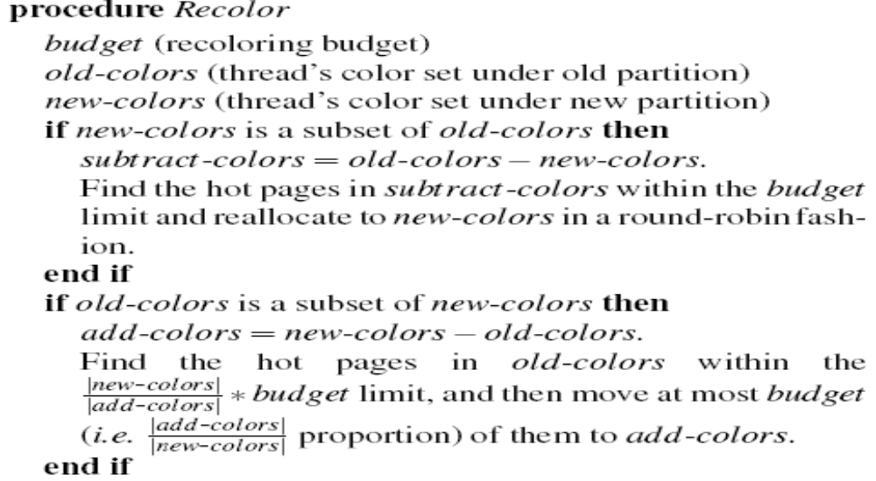
Re-coloring Procedure
Quick search for K-th hottest page’s hotness
  Bin[ i ][ j ] indicates # of pages in color i with normalized hotness in
  [ j, j+1] range
Bad…

Slide 30
Instead …

Slide 31
Re-coloring Procedure(I)
hot
warm
cold
Cache share decrease
Budget = 2 pages
Old colors
Subtract colors

Slide 32
The end of the talk…
Conclusions
  Don’t just repeat what you did
  Use this as a chance to broaden your scope
  What are the implications of what you did?
  What did you learn?
Conclusions as Takeaway Message
  What are 2-3 things you want the audience to remember?
    If you give them 6, they remember none.
  Give them at least one number (“2X improvement”, “30% lower hardware complexity”, …)

Slide 33
The end of the talk… Part II
The Post-Talk Questions
  A bungled question is unfortunately very memorable…
Prepare for them! They are part of the talk!
  Hold practice sessions with a broad audience to get questions from researchers in slightly different areas
  Have a friend record all questions asked (or video-record) so you can prepare backup slides

Slide 34
The Post-Talk Questions… Part II
During the Question Session:
  Repeat/rephrase each question asked
      1) Helps back of room hear what was asked
      2) Ensures that you actually understand the question and are answering what was asked
      3) Gives you time to formulate a good answer
If they ask “Did you try XYZ…”
  Not-so-good answer: “No.”
  Slightly better: “No, but that would be a natural for future work”
  Better answer “No, but we did try ABC and saw that it only helped by 5% which led us to surmise that XYZ would also perform similarly”
Try to give things a short but complete answer and then move on. Don’t ask “Did that answer your question?”
When in doubt, “That’s an interesting question, but perhaps it would be easier to take the answer offline”

Slide 35
PRACTICE, PRACTICE, PRACTICE!
Build your confidence; get feedback; form a support group; return the favor

Slide 36
More Hints
Tape yourself and watch the tape
Enroll in a public speaking class
  Toastmasters, community courses
Memorize first 5 minutes of your talk
  Helps start out if you are nervous
Script the main ideas of the talk so you practice where to say key points.
  Then throw the script away so your talk will not sound too robotic or pre-planned…
  Practice for length without script
Ok to take brief clarifying questions on the fly, but defer anything non-trivial to the end
Beware animations
Find out dress code in advance (ties rarely appropriate)

Slide 37
Body Language
Eye contact
Fillers
Gestures
Enunciation
Voice modulation and emphasis
Speed of delivery
  There’s no prize for learning how to fit 20 words in 10 seconds
Most of all, project your enthusiasm for what you are presenting!

Slide 38
Logistical Details
Redundancy/fault tolerance: make copies of your slides on a flash drive as well as in the Cloud
  Your computer may fail you
Create versions in multiple formats for just in case
  E.g., ppt and pdf
Make sure you check the projection systems prior to your talk or session if at a conference
Turn off automatic time-based transitions in powerpoint
  Also turn off wireless, notifications, screen saver, etc.
Plug in your laptop to avoid power-save modes or battery problems.
Use your own laptop if at all possible!

Slide 39
Outline
Conference Talk tips
“Elevator Pitch” or hallway conversation
Poster session
Summary and closing thoughts

Slide 40
The Elevator Pitch or Hallway Conversation
Scene 1: You step into an elevator and realize that {Bill Gates, Sergei Brin, …} just walked in. The door closes. You have ~30 seconds to explain to them what you do.
Scene 2: You are at a conference and you have a chance to discuss your work with one of the research leaders of your field. You have ~30 seconds to start a conversation with them about what you do.
What do you say?

Slide 41
Exercise
Practice an elevator pitch or 30-second conversation with your table
Time it!
Offer suggestions for improvements
Remember these:
  What is the problem?
  Why is it important?
  What have others done about it?
  What am I doing about it?
    That is useful, novel, interesting, different…

Slide 42
Outline
Conference Talk tips
“Elevator Pitch” or hallway conversation
Poster session
Summary and closing thoughts

Slide 43
Poster Presentation
Start with elevator pitch (30 seconds)
Elaborate on methods and outcomes
Use figures and diagrams on poster to illustrate what you say.
Poster content
  Once again, pictures speak a 1000 words
    With some help from text
    Don’t overcrowd
    Make sure the main points stand out

Slide 44
Posters: Follow-Up Questions
Be prepared to
  Discuss approach in more detail
  Discuss validation in more detail
  Discuss limitations of your work
  Discuss related work
  Outline ongoing and future work

Slide 45
Outline
Conference Talk tips
“Elevator Pitch” or hallway conversation
Poster session
Summary and closing thoughts

Slide 46
Advice from various people…
Part 1: Graphs & Visuals
Note that up to 10% of males have red/green color blindness, and there are a lot of males in our field. So don't make bar charts with equally bright bars of red and green; use stripes or something to distinguish the bars
If you put a chart on the screen you have to explain it
Always label all axes of your graphs (in a legible font)
Don't ask the audience to compare by memory to a graph from a previous slide. If you want me to compare 2 sets of results and see how much you improved things, put them on the same slide so I can see the data side by side

Slide 47
Advice from various people…
Part 2: Delivery
The two things I find most amateurish about Powerpoint presentations:
  Too much text
  Inability to skip slides when pressed for time
Start preparing your talk more than 48 hours in advance
Give a practice talk to get feedback and likely questions
Have fun! Be energetic! A really jazzed presenter can help the audience get excited about the topic, and on the flip-side, if the presenter looks bored, you can guess how 95% of the audience must feel...
Record yourself or have someone watch - look for odd body movements (rocking back and forth, waving hands) “um”s, etc.

Slide 48
Summary
Keep your audience and goals in mind
  Don’t ramble or meander: The destination and route should always be clear.
Just like playing tennis or piano, giving good presentations is a skill that can be practiced and improved!
  Practice for your talks. Look for opportunities to give talks. Practice elevator pitches with your friends often.
Remember the Big Four Questions:
  What is the problem?
  Why is it important?
  What have others done about it?
  What have I done?

Slide 49
Useful Resources
Oral:
David Patterson: How to Give a Bad Talk
http://pages.cs.wisc.edu/~markhill/conference-talk.html#badtalk
Mark Hill’s “Oral Presentation Advice”, http://pages.cs.wisc.edu/~markhill/conference-talk.html
CRA-W, http://www.cra-w.org/gradcohort
http://www.randsinrepose.com/archives/2008/02/03/out_loud.html
http://www.slideshare.net/selias22/taking-your-slide-deck-to-the-next-level
http://www.presentationzen.com/
Written:
Strunk & White “The Elements of Style”
Gopen & Swan “The Science of Scientific Writing” http://www.americanscientist.org/issues/feature/the-science-of-scientific-writing/9
Many schools provide many writing resources: Use them!
  Writing center or tutor.
Also, it may be worthwhile to *pay* a writing tutor to help teach you and edit your work, in order to make your overall idea-to-paper process easier!
General:
Female Science Professor blog!
http://science-professor.blogspot.com/

